Slide 1
Rainforest Animals

Slide 2
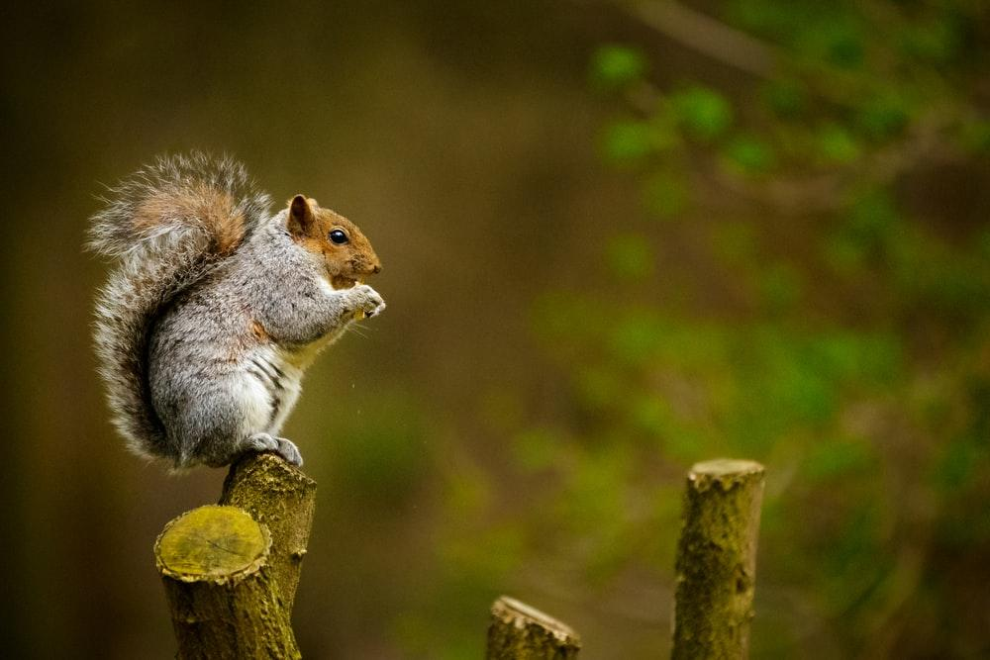
Squirrel

Slide 3
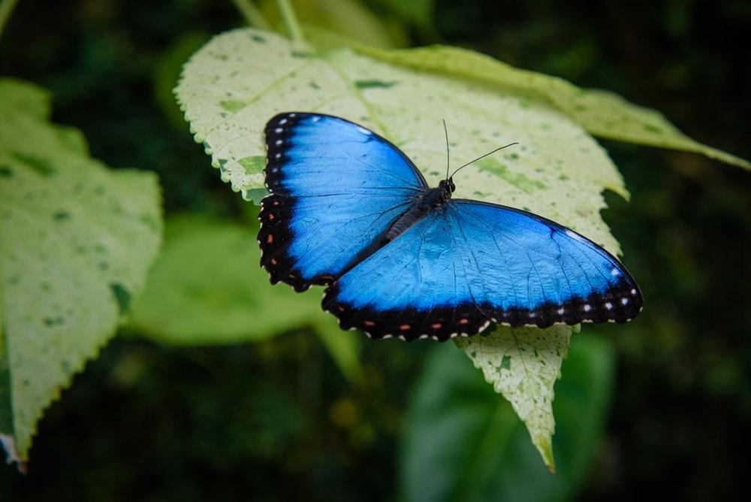
Butterfly

Slide 4
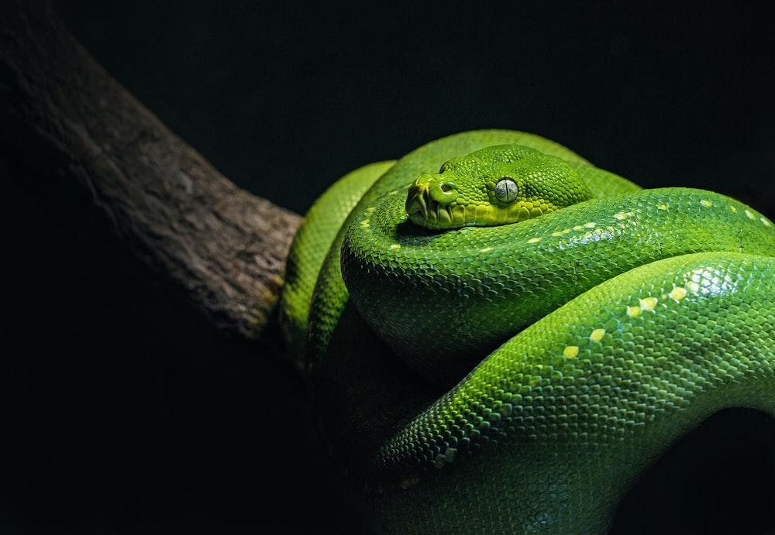
Snake

Slide 5
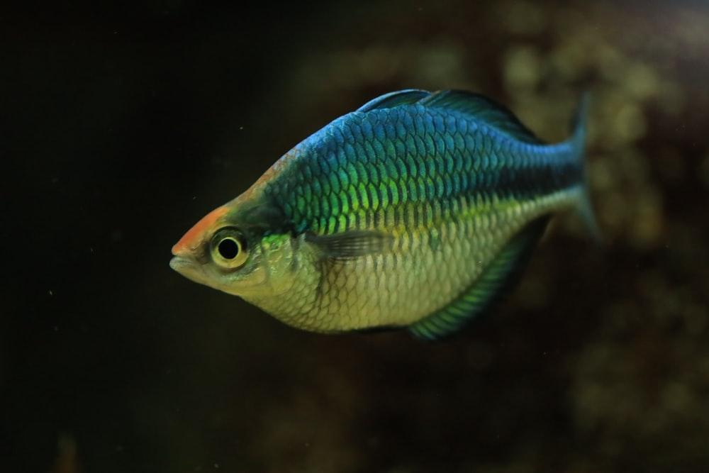
Fish

Slide 6
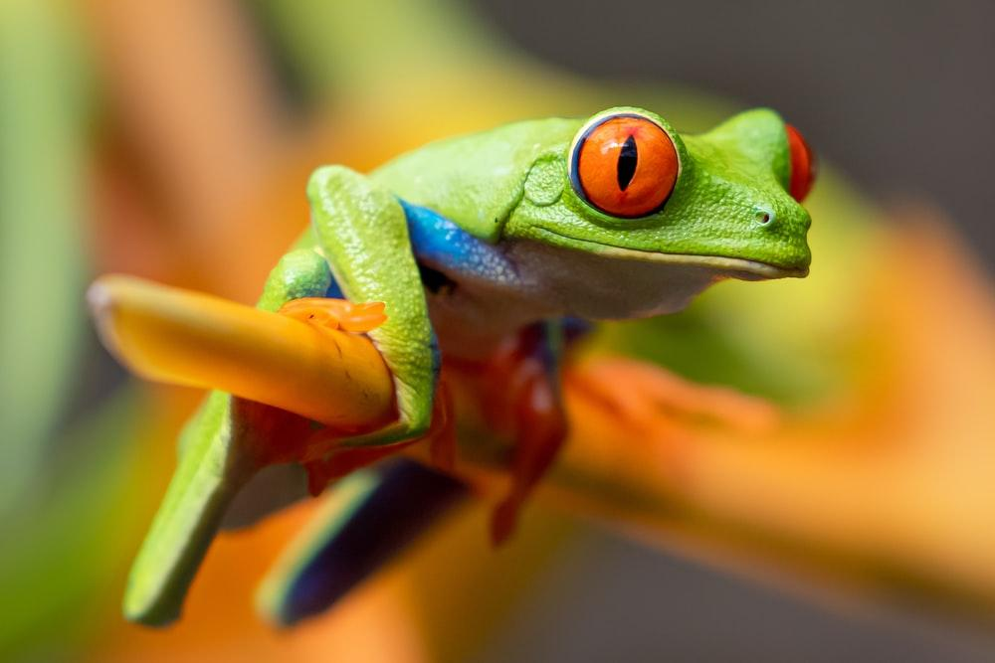
Frog

Slide 7
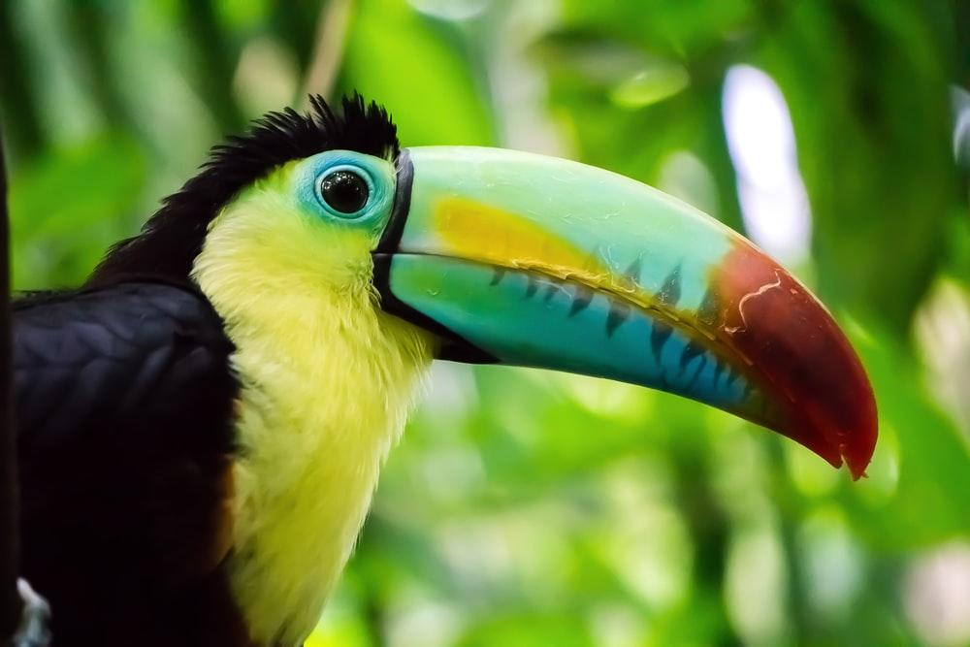
Toucan

Slide 8
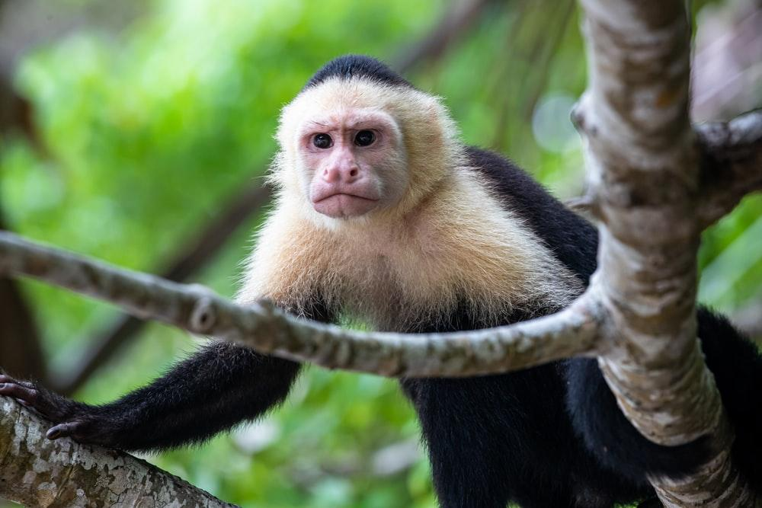
Monkey

Slide 9
Sloth

Slide 10
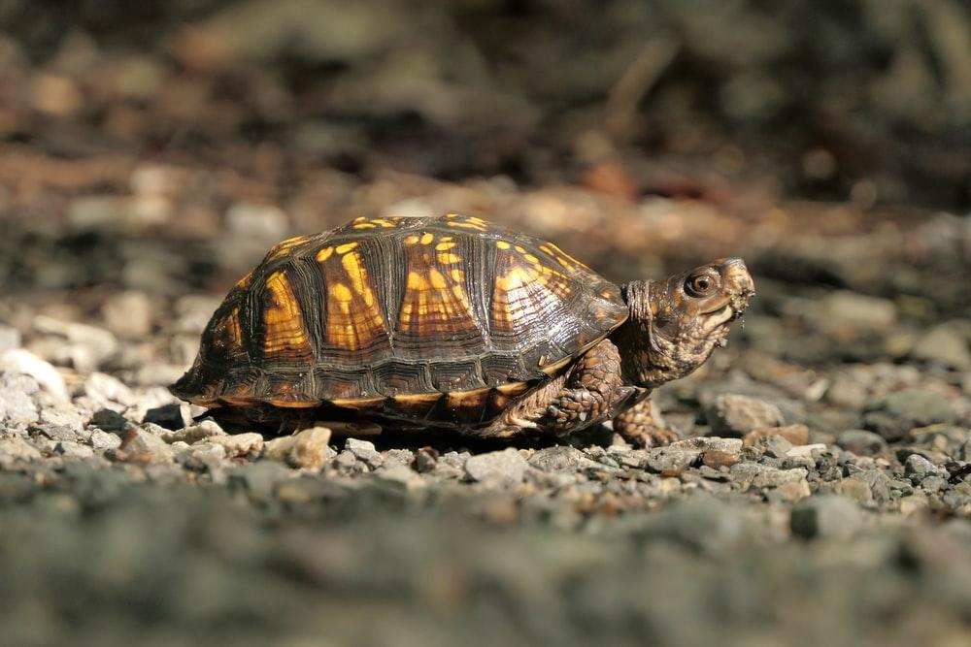
Turtle

Slide 11
Let’s review one more time

Slide 12
Squirrel/Trees

Slide 13
Butterfly/Air

Slide 14
Snake/Trees/Ground

Slide 15
Fish/Water

Slide 16
Frog/Trees

Slide 17
Toucan/Trees/Air

Slide 18
Monkey/Trees

Slide 19
Sloth/Trees

Slide 20
Turtle/Ground

Slide 21
Name the animals

